Slide 1
Hopper Support in Triton Jun Yang on behalf of the great team efforts

Slide 2
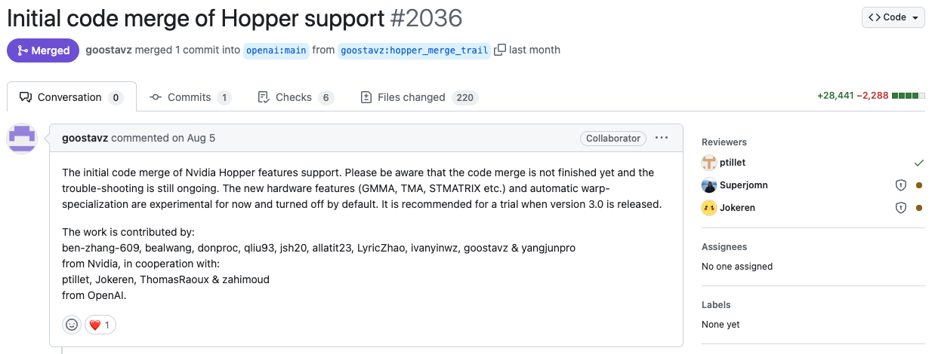
Acknowledgement
Great collaboration between NVIDIA and OpenAI

Slide 3
Agenda
• | Motivation
• | New Features & API Changes
• | Dialects & Pass pipelines
• | Performance
 | Plans for the future

Slide 4


Recap
Triton makes a trade-off between development efficiency and performance
More buttons for the geeks
Users precisely control the behavior of each thread
More general in different domains
Longer learning curve & higher development costs
Best ultimate performance
Lower lower-bound and higher higher-bound
CUDA
‘Point and shoot’ for ‘primary’ users
Users describe the computation of each block
Much less buttons / knobs, easier to get started
The Triton compiler takes over the optimizations within block level
Trade-off
Not suitable for hi-end users with stronger requirements
Much less buttons/knobs
Only work for specific domains
Higher lower-bound but lower higher-bound
May get more valuable along with the evolution of hardware architecture
Triton

Slide 5
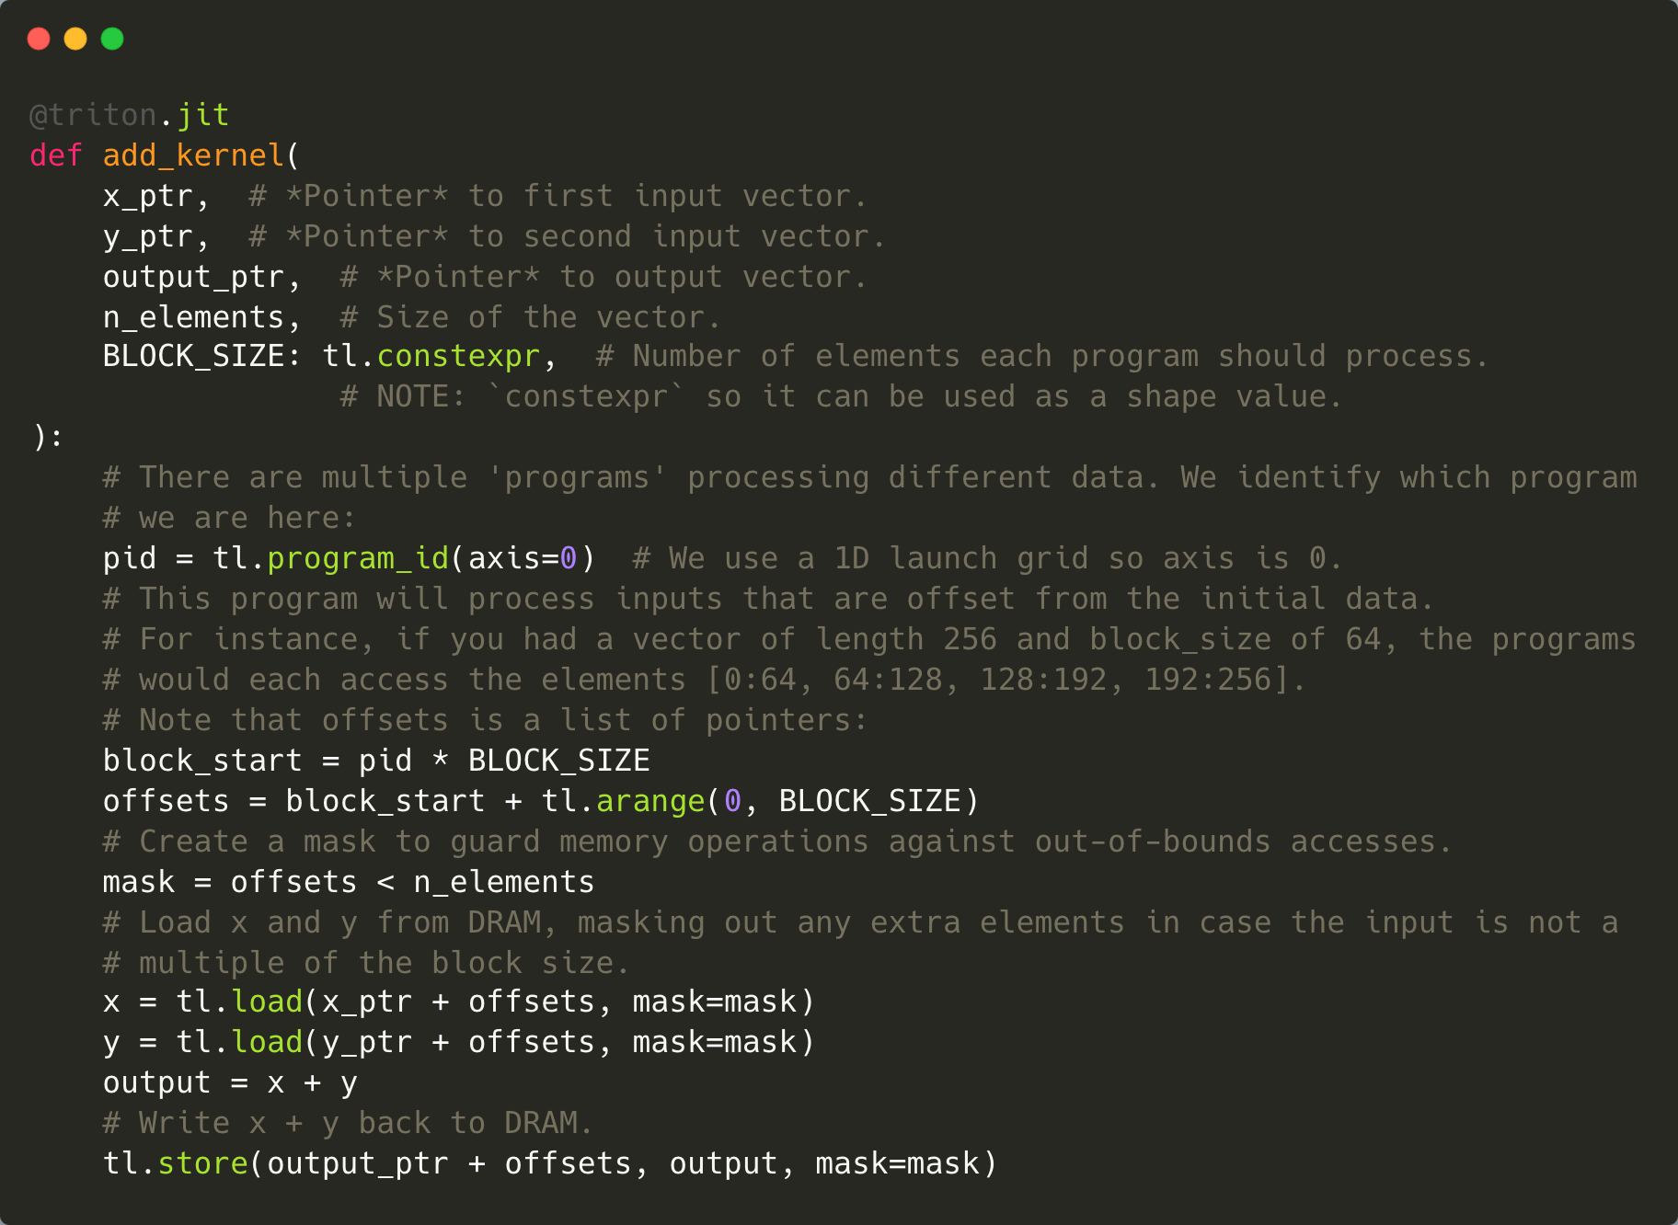
Recap
Triton’s solution on Ampere for the ‘point and shoot’ product positioning
Within 10 lines
Python-like
Programming for CTA
Automatic backend

Slide 6
Recap
Naïve GEMM as an example
@triton.jit
def matmul_kernel(
a_ptr, b_ptr, c_ptr,
stride_am, stride_ak,
stride_bk, stride_bn,
stride_cm, stride_cn,
M: tl.constexpr, N: tl.constexpr, K: tl.constexpr, # M=N=K=1024
BLOCK_M: tl.constexpr, BLOCK_N: tl.constexpr, BLOCK_K: tl.constexpr, #BLOCK_M=BLOCK_N=BLOCK_K=32
):
offs_m = tl.arange(0, BLOCK_M)
offs_n = tl.arange(0, BLOCK_N)
offs_k = tl.arange(0, BLOCK_K)
a_ptrs = a_ptr + offs_m[:, None] * stride_am + offs_k[None, :] * stride_ak
b_ptrs = b_ptr + offs_k[:, None] * stride_bk + offs_n[None, :] * stride_bn
accumulator = tl.zeros((BLOCK_M, BLOCK_N), dtype=tl.float32)
for k in range(0, K, BLOCK_K):
a = tl.load(a_ptrs)
b = tl.load(b_ptrs)
accumulator += tl.dot(a, b)
a_ptrs += BLOCK_K * stride_ak
b_ptrs += BLOCK_K * stride_bk
c_ptrs = c_ptr + offs_m[:, None] * stride_cm + offs_n[None, :] * stride_cn
tl.store(c_ptrs, accumulator)
Data Load/Store operations)
Dot operations

Slide 7
Recap
Triton IR
module {
func public @matmul_kernel_0d1d2d3d4c5d6c7d8c(
%arg0: !tt.ptr<f16> {tt.divisibility = 16 : i32}, ...
%c32_i32 = arith.constant 32 : i32
%cst = arith.constant dense<32> : tensor<32x32xi32>
%c32 = arith.constant 32 : index
%c1024 = arith.constant 1024 : index
%c0 = arith.constant 0 : index
%cst_0 = arith.constant dense<0.000000e+00> : tensor<32x32xf32>
%0 = tt.make_range {end = 32 : i32, start = 0 : i32} : tensor<32xi32>
%1 = tt.expand_dims %0 {axis = 1 : i32} : (tensor<32xi32>) -> tensor<32x1xi32>
%2 = tt.splat %arg3 : (i32) -> tensor<32x1xi32>
%3 = arith.muli %1, %2 : tensor<32x1xi32>
...
%11 = arith.muli %1, %10 : tensor<32x1xi32>
%12 = tt.splat %arg1 : (!tt.ptr<f16>) -> tensor<32x1x!tt.ptr<f16>>
%13 = tt.addptr %12, %11 : tensor<32x1x!tt.ptr<f16>>, tensor<32x1xi32>
%14 = tt.broadcast %13 : (tensor<32x1x!tt.ptr<f16>>) -> tensor<32x32x!tt.ptr<f16>>
%15 = tt.addptr %14, %8 : tensor<32x32x!tt.ptr<f16>>, tensor<32x32xi32>
%16:3 = scf.for %arg6 = %c0 to %c1024 step %c32 iter_args(%arg7 = %cst_0, %arg8 = %9, %arg9 = %15) -> (...)
%24 = tt.load %arg8 {cache = 1 : i32, evict = 1 : i32, isVolatile = false} : tensor<32x32xf16>
%25 = tt.load %arg9 {cache = 1 : i32, evict = 1 : i32, isVolatile = false} : tensor<32x32xf16>
%26 = tt.dot %24, %25, %arg7 {allowTF32 = true} : tensor<32x32xf16> * tensor<32x32xf16> -> tensor<32x32xf32>
%27 = tt.addptr %arg8, %cst : tensor<32x32x!tt.ptr<f16>>, tensor<32x32xi32>
%28 = arith.muli %arg4, %c32_i32 : i32
%29 = tt.splat %28 : (i32) -> tensor<32x32xi32>
%30 = tt.addptr %arg9, %29 : tensor<32x32x!tt.ptr<f16>>, tensor<32x32xi32>
scf.yield %26, %27, %30 : tensor<32x32xf32>, tensor<32x32x!tt.ptr<f16>>, tensor<32x32x!tt.ptr<f16>>
}
%17 = tt.splat %arg5 : (i32) -> tensor<32x1xi32>
%18 = arith.muli %1, %17 : tensor<32x1xi32>
%19 = tt.splat %arg2 : (!tt.ptr<f16>) -> tensor<32x1x!tt.ptr<f16>>
%20 = tt.addptr %19, %18 : tensor<32x1x!tt.ptr<f16>>, tensor<32x1xi32>
%21 = tt.broadcast %20 : (tensor<32x1x!tt.ptr<f16>>) -> tensor<32x32x!tt.ptr<f16>>
%22 = tt.addptr %21, %8 : tensor<32x32x!tt.ptr<f16>>, tensor<32x32xi32>
%23 = arith.truncf %16#0 : tensor<32x32xf32> to tensor<32x32xf16>
tt.store %22, %23 {cache = 1 : i32, evict = 1 : i32} : tensor<32x32xf16>
return
}
}
Load tile from gmem to shared memory, will get decomposed into 4 vectorized LDGSTS instructions:
mov.u32 %r45, 16;
cp.async.cg.shared.global [ %r44 + 0 ], [ %rd11 + 0 ], 0x10, %r45;
cp.async.cg.shared.global [ %r46 + 0 ], [ %rd12 + 0 ], 0x10, %r45;
cp.async.cg.shared.global [ %r48 + 0 ], [ %rd13 + 0 ], 0x10, %r45;
cp.async.cg.shared.global [ %r50 + 0 ], [ %rd14 + 0 ], 0x10, %r45;
mma on tile, will get decomposed into 4 MMA instructions with the corresponding ldmatrix instructions(on Ampere)
ldmatrix.sync.aligned.m8n8.x4.shared.b16 { %r236, %r237, %r238, %r239 }, [ %r56 + 0 ];
…
ldmatrix.sync.aligned.m8n8.x4.trans.shared.b16 { %r232, %r233, %r234, %r235 }, [ %r61 + 0 ];
…
ldmatrix.sync.aligned.m8n8.x4.shared.b16 { %r138, %r139, %r140, %r141 }, [ %r120 + 0 ];
…
ldmatrix.sync.aligned.m8n8.x4.trans.shared.b16 { %r121, %r122, %r123, %r124 }, [ %r125 + 0 ];
mma.sync.aligned.m16n8k16.row.col.f32.f16.f16.f32 { %f65, %f66, %f67, %f68 },
{ %r236, %r237, %r238, %r239 }, { %r232, %r233 }, { %f65, %f66, %f67, %f68 };
mma.sync.aligned.m16n8k16.row.col.f32.f16.f16.f32 { %f69, %f70, %f71, %f72 },
{ %r236, %r237, %r238, %r239 }, { %r234, %r235 }, { %f69, %f70, %f71, %f72 };
mma.sync.aligned.m16n8k16.row.col.f32.f16.f16.f32 { %f65, %f66, %f67, %f68 },
{ %r138, %r139, %r140, %r141 }, { %r121, %r122 }, { %f65, %f66, %f67, %f68 };
mma.sync.aligned.m16n8k16.row.col.f32.f16.f16.f32 { %f69, %f70, %f71, %f72 },
{ %r138, %r139, %r140, %r141 }, { %r123, %r124 }, { %f69, %f70, %f71, %f72 };
Store from register files to gmem, will get decomposed into 1 vectorized store instruction:
st.global.v4.b32 [ %rd32 + 0 ], { %r158, %r159, %r160, %r161 };

Slide 8
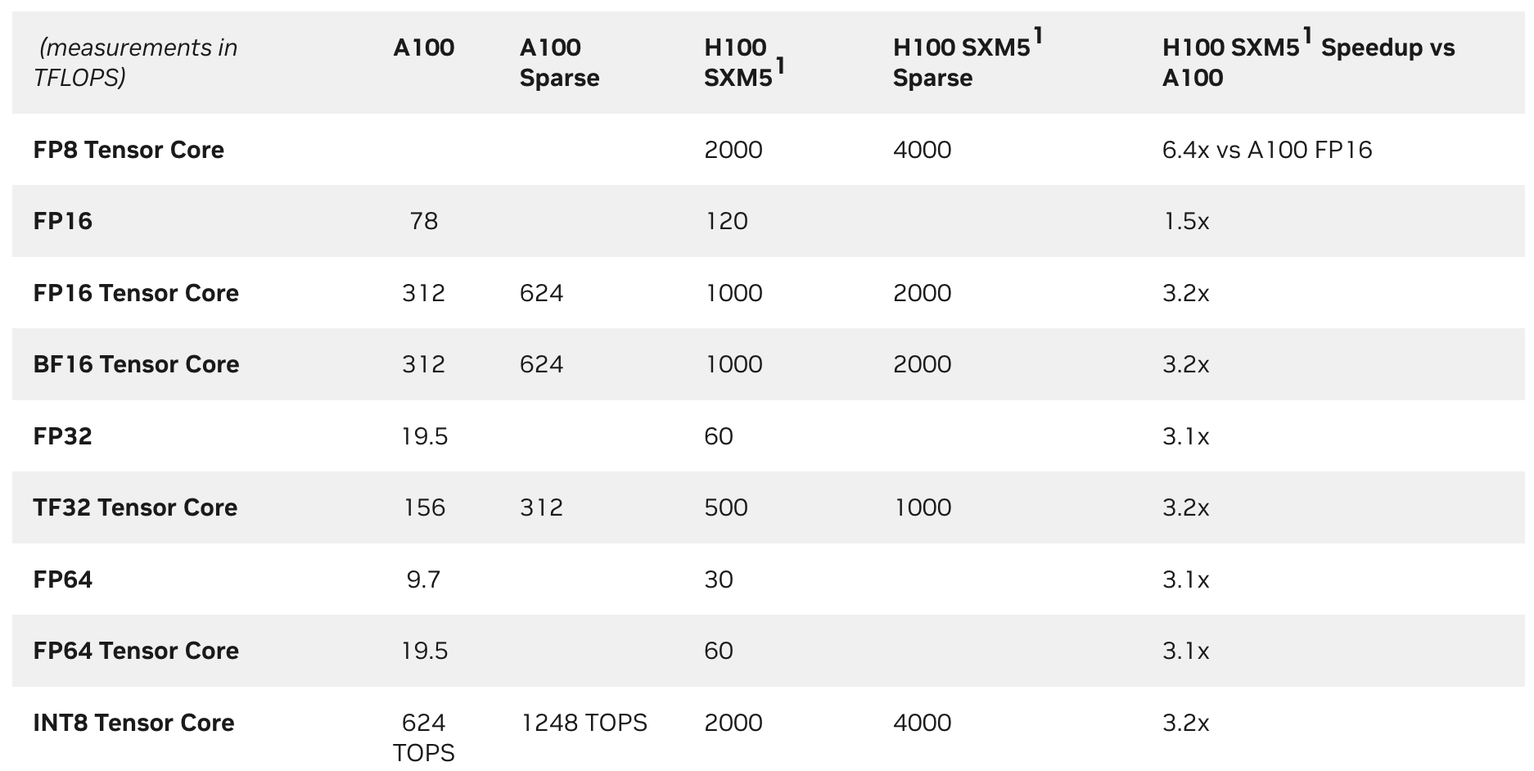
Motivation
Triton supports Hopper with decent performance and few additional complexity
H100 speedup over A100 (TC=Tensor Core)

Slide 9
Motivation
Challenges
New hardware features
TMA (multicast)
WGMMA
Distributed shared memory
…
Minimize the changes on frontend APIs
Backward compatibility
Future extensibility
New methodologies in writing kernels
Heuristics on Ampere might be outdated
Warp specialization challenges many aspects of Triton
Changes
Frontend
New load/store APIs to adapt to TMA
Programming on CTA -> Programming on CGA
Op definition changes of tt/ttgpu dialect
Backend
triton::NVGPU dialect
runtime to maintain TMA descriptors
WGMMA, TMA ..
Optimizer pass pipeline
PlanCTA pass to do the tiling from CGA to CTA
Backward compatibility of new load/store APIs
Changes on the existing pass pipeline to adapt to new hardware features
Warp specialization passes

Slide 10
Agenda
• | Motivation
• | New Features & API Changes
• | Dialects & Pass pipelines
• | Performance
• | Plans for the future

Slide 11
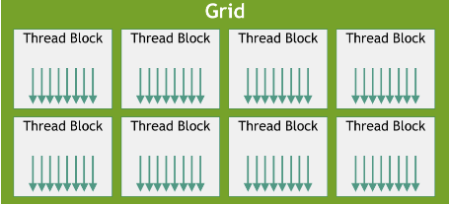
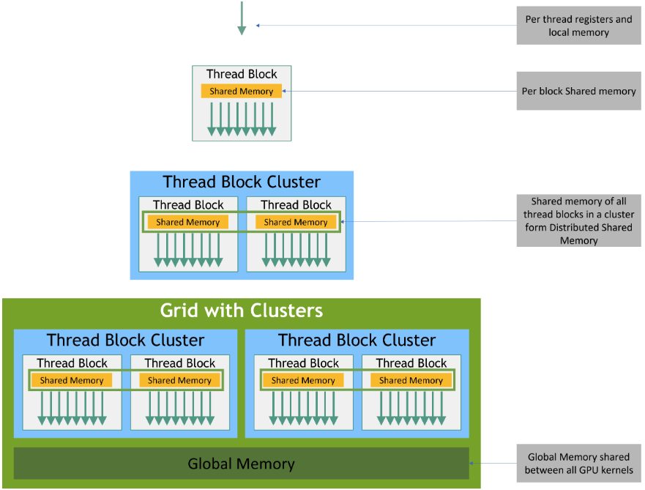
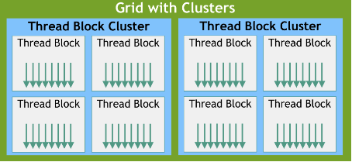
New features of Hopper
Clusters(CGA) and Distributed Shared Memory
Programming model
Memory Hierarchy

Slide 12
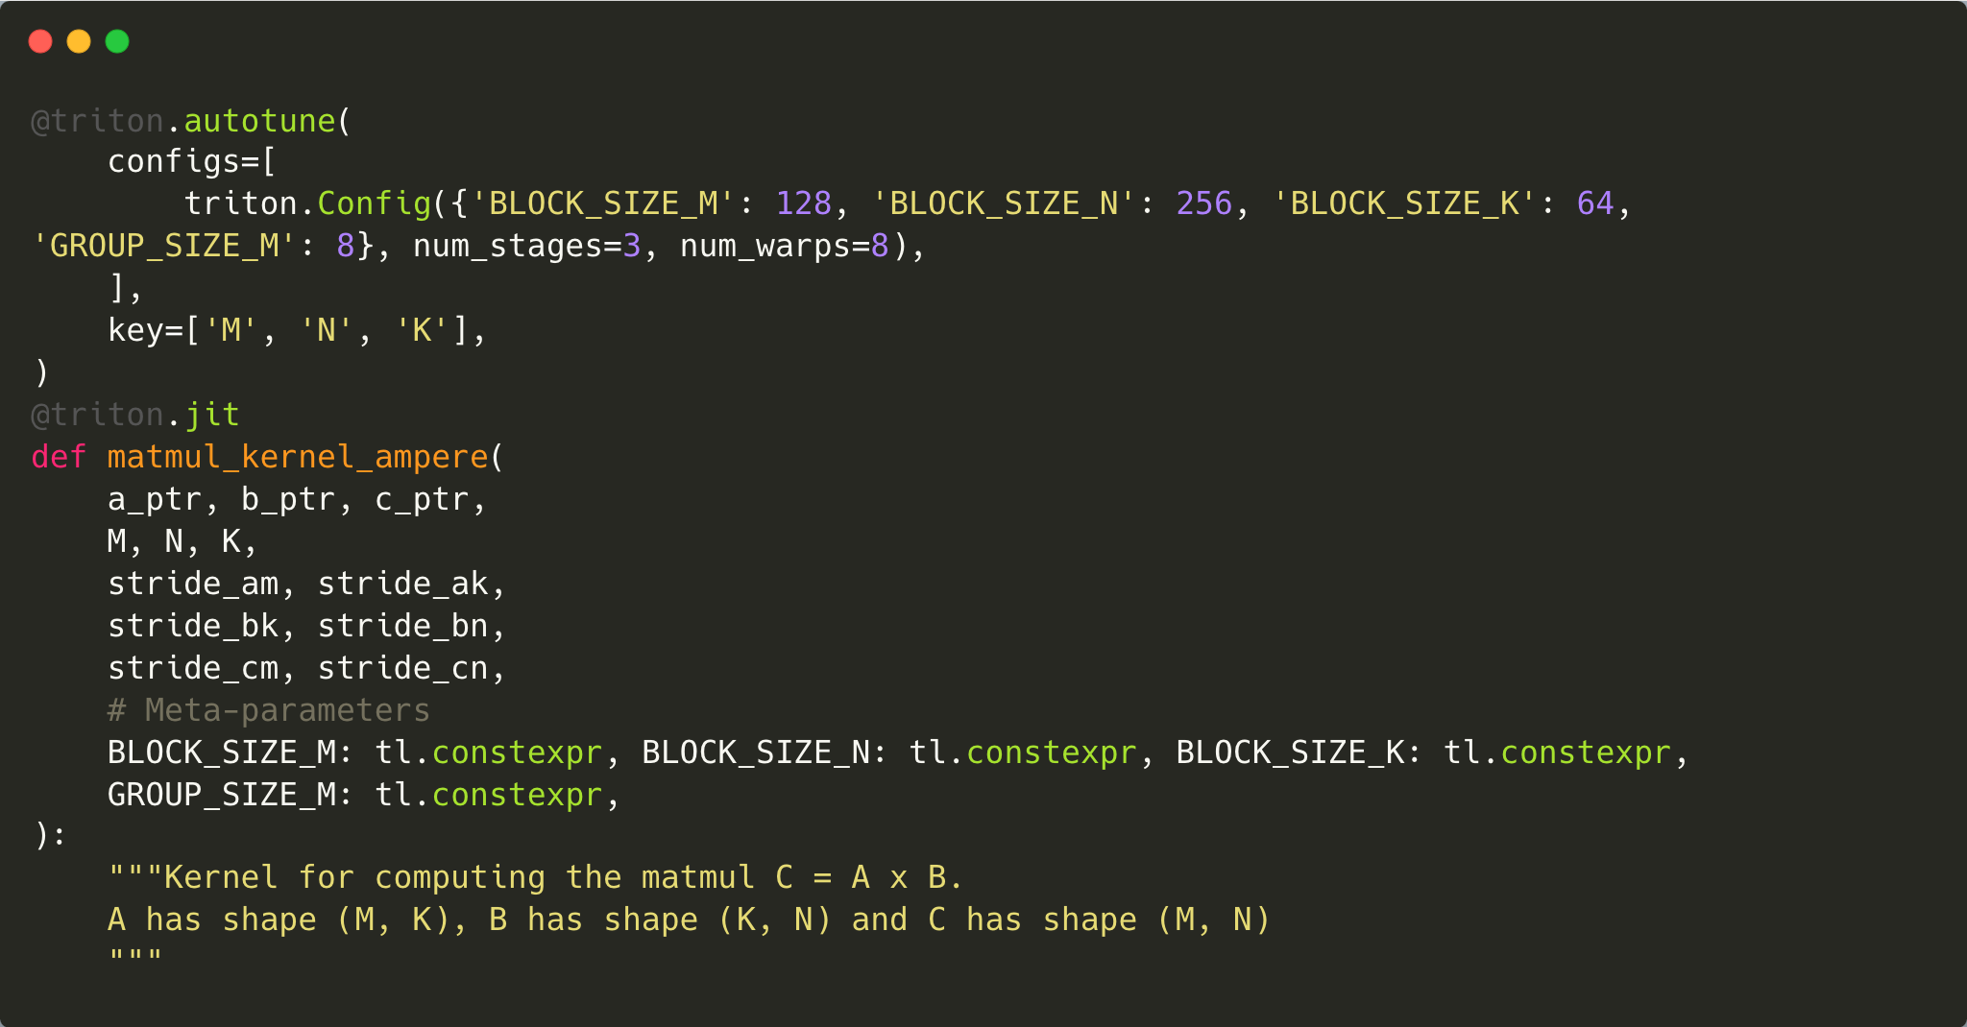
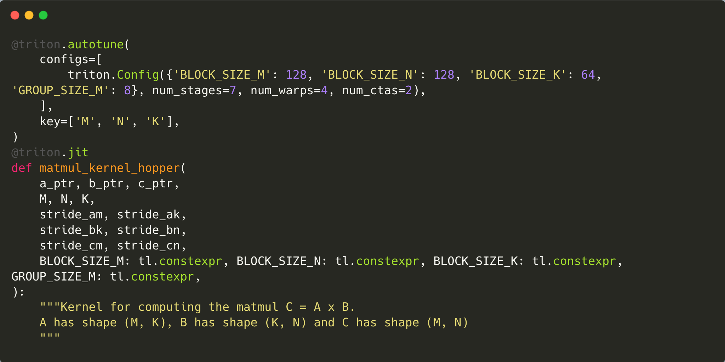
New API for CGA programming
Hide the complexity of CGA->CTA tiling and distributed shared memory

Slide 13
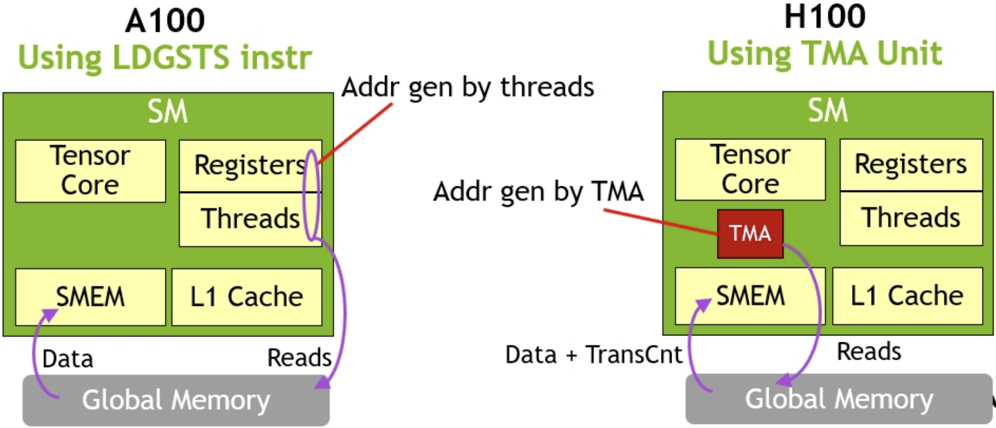
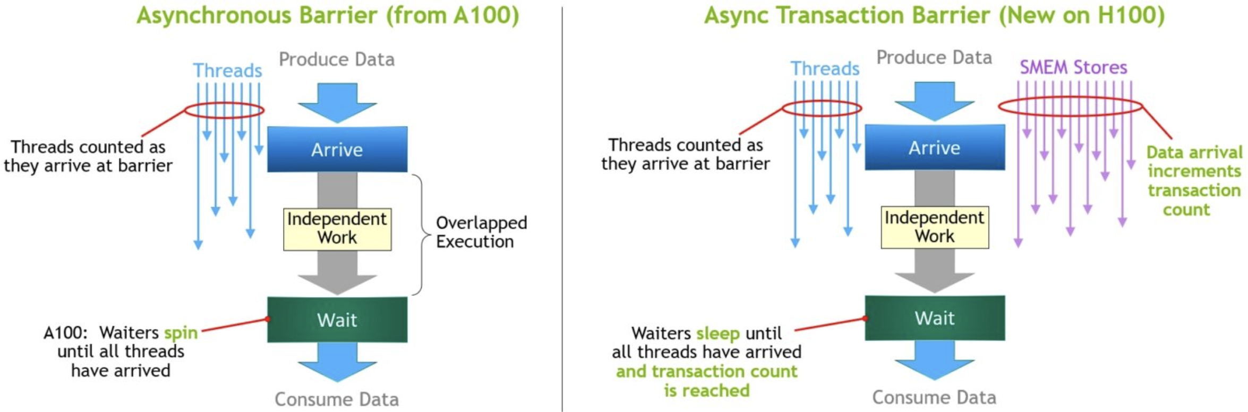
New features of Hopper
TMA Multicast and Asynchronous Transaction Barrier
Asynchronous memory copy with TMA on H100 vs. LDGSTS on A100
Asynchronous barrier in A100 vs. asynchronous transaction barrier in H100

Slide 14
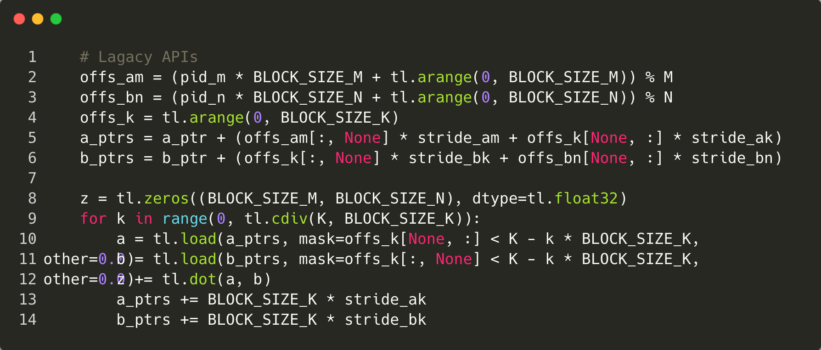
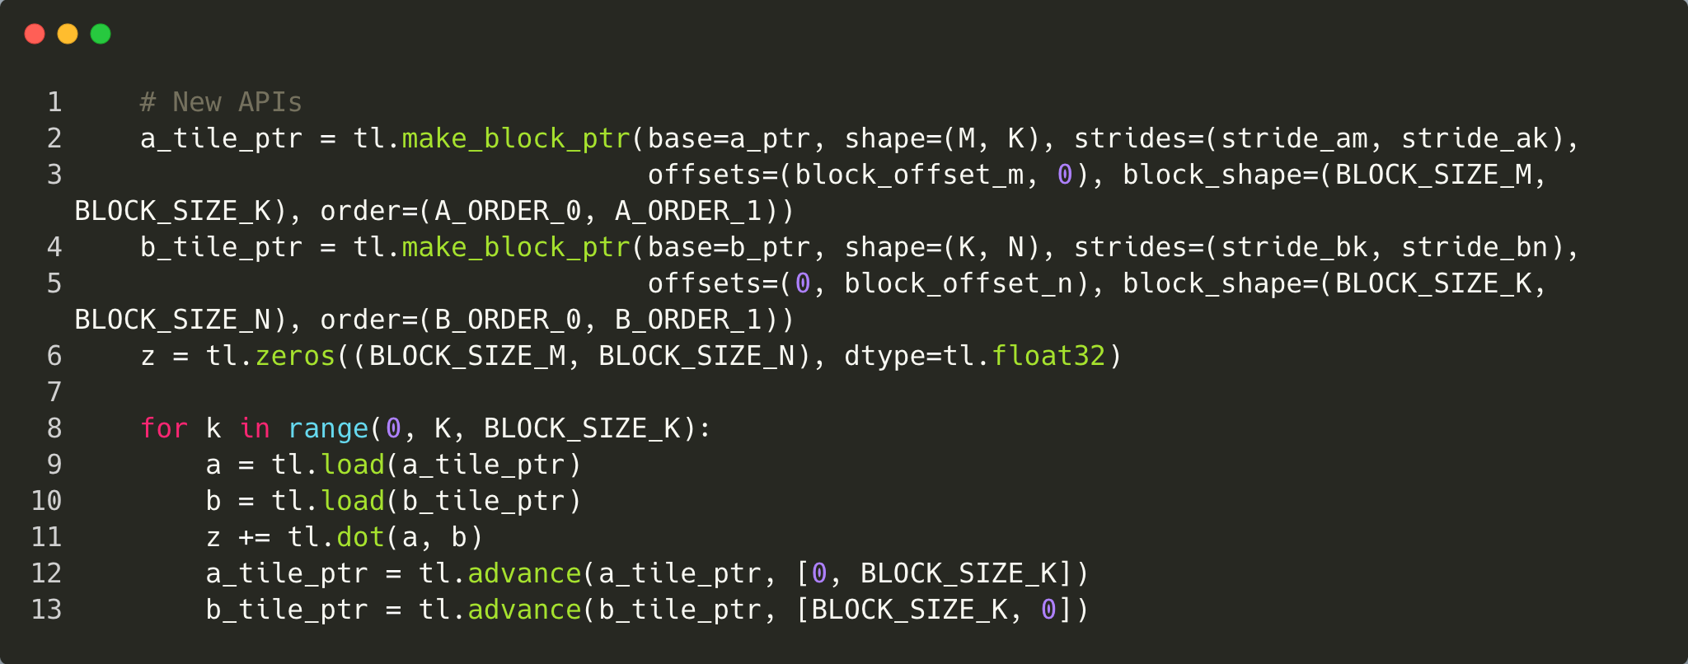
New load/store APIs for TMA
Reduce instructions for address generation
Implicit inbound check
A RewriteTensorPointer pass was added for backward compatibility on pre-Hopper
Users are recommended to use new APIs as much as possible

Slide 15
New Load/Store APIs for TMA
Examples
rm = pid_m * BLOCK_M + tl.arange(0, BLOCK_M)
rn = pid_n * BLOCK_N + tl.arange(0, BLOCK_N)
ram = tl.max_contiguous(tl.multiple_of(rm % M, BLOCK_M), BLOCK_M)
rbn = tl.max_contiguous(tl.multiple_of(rn % N, BLOCK_N), BLOCK_N)
rk = pid_z * BLOCK_K + tl.arange(0, BLOCK_K)
# pointers
A = A + (ram[:, None] * stride_am + rk[None, :] * stride_ak)
B = B + (rk[:, None] * stride_bk + rbn[None, :] * stride_bn)
acc = tl.zeros((BLOCK_M, BLOCK_N), dtype=dot_out_dtype)
for k in range(0, tl.cdiv(K, BLOCK_K * SPLIT_K)):
if EVEN_K:
a = tl.load(A)
b = tl.load(B)
else:
k_remaining = K - k * (BLOCK_K * SPLIT_K)
a = tl.load(A, mask=rk[None, :] < k_remaining, other=0.)
b = tl.load(B, mask=rk[:, None] < k_remaining, other=0.)
acc += tl.dot(a, b, out_dtype=dot_out_dtype)
A += BLOCK_K * SPLIT_K * stride_ak
B += BLOCK_K * SPLIT_K * stride_bk
A = tl.make_block_ptr(A, shape=(M, K),
strides=(stride_am, stride_ak),
offsets=(pid_m * BLOCK_M, pid_z * BLOCK_K),
block_shape=(BLOCK_M, BLOCK_K),
order=(1, 0))
B = tl.make_block_ptr(B, shape=(K, N),
strides=(stride_bk, stride_bn),
offsets=(pid_z * BLOCK_K, pid_n * BLOCK_N),
block_shape=(BLOCK_K, BLOCK_N),
order=(1, 0))
acc = tl.zeros((BLOCK_M, BLOCK_N), dtype=dot_out_dtype)
for k in range(0, tl.cdiv(K, BLOCK_K * SPLIT_K)):
if EVEN_K:
a = tl.load(A)
b = tl.load(B)
else:
a = tl.load(A, boundary_check=(1, ), padding_option="zero")
b = tl.load(B, boundary_check=(0, ), padding_option="zero")
acc += tl.dot(a, b, out_dtype=dot_out_dtype)
A = tl.advance(A, (0, BLOCK_K * SPLIT_K))
B = tl.advance(B, (BLOCK_K * SPLIT_K, 0))
Legacy APIs
New APIs

Slide 16
New Load/Store APIs for TMA
Examples
rm = pid_m * BLOCK_M + tl.arange(0, BLOCK_M)
rn = pid_n * BLOCK_N + tl.arange(0, BLOCK_N)
ram = tl.max_contiguous(tl.multiple_of(rm % M, BLOCK_M), BLOCK_M)
rbn = tl.max_contiguous(tl.multiple_of(rn % N, BLOCK_N), BLOCK_N)
rk = pid_z * BLOCK_K + tl.arange(0, BLOCK_K)
# pointers
A = A + (ram[:, None] * stride_am + rk[None, :] * stride_ak)
B = B + (rk[:, None] * stride_bk + rbn[None, :] * stride_bn)
acc = tl.zeros((BLOCK_M, BLOCK_N), dtype=dot_out_dtype)
for k in range(0, tl.cdiv(K, BLOCK_K * SPLIT_K)):
if EVEN_K:
a = tl.load(A)
b = tl.load(B)
else:
k_remaining = K - k * (BLOCK_K * SPLIT_K)
a = tl.load(A, mask=rk[None, :] < k_remaining, other=0.)
b = tl.load(B, mask=rk[:, None] < k_remaining, other=0.)
acc += tl.dot(a, b, out_dtype=dot_out_dtype)
A += BLOCK_K * SPLIT_K * stride_ak
B += BLOCK_K * SPLIT_K * stride_bk
A = tl.make_block_ptr(A, shape=(M, K),
strides=(stride_am, stride_ak),
offsets=(pid_m * BLOCK_M, pid_z * BLOCK_K),
block_shape=(BLOCK_M, BLOCK_K),
order=(1, 0))
B = tl.make_block_ptr(B, shape=(K, N),
strides=(stride_bk, stride_bn),
offsets=(pid_z * BLOCK_K, pid_n * BLOCK_N),
block_shape=(BLOCK_K, BLOCK_N),
order=(1, 0))
acc = tl.zeros((BLOCK_M, BLOCK_N), dtype=dot_out_dtype)
for k in range(0, tl.cdiv(K, BLOCK_K * SPLIT_K)):
a = tl.load(A, boundary_check=(1, ), padding_option="zero")
b = tl.load(B, boundary_check=(0, ), padding_option="zero")
acc += tl.dot(a, b, out_dtype=dot_out_dtype)
A = tl.advance(A, (0, BLOCK_K * SPLIT_K))
B = tl.advance(B, (BLOCK_K * SPLIT_K, 0))
Legacy APIs
New APIs could be even simpler. This brings no performance drop on Hopper, and minor performance drop on pre-Hopper

Slide 17
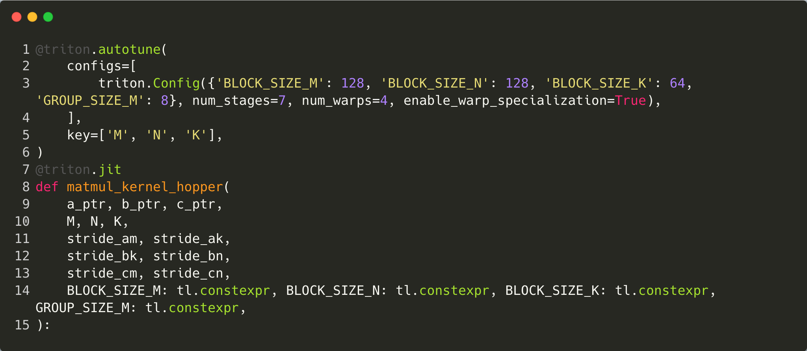
New API for Automatic Warp Specialization(Preview)
Better overlapping between data movement and math instructions
The peak perf of Hopper is up to 6x faster than Ampere, but the bandwidth has not increased so much.
Overlapping between data movement and math instructions as much as possible is vital for good performance.
Time Line
Warp group1
Tile1
Prelogue
Tile2
Prelogue
Tile3
Prelogue
Tile4
Prelogue
Warp group2
Tile1 Math | Tile1 Epilogue
Tile3 Math | Tile3 Epilogue
Warp group3
Tile2 Math | Tile2 Epilogue
Tile4 Math | Tile4 Epilogue

Slide 18
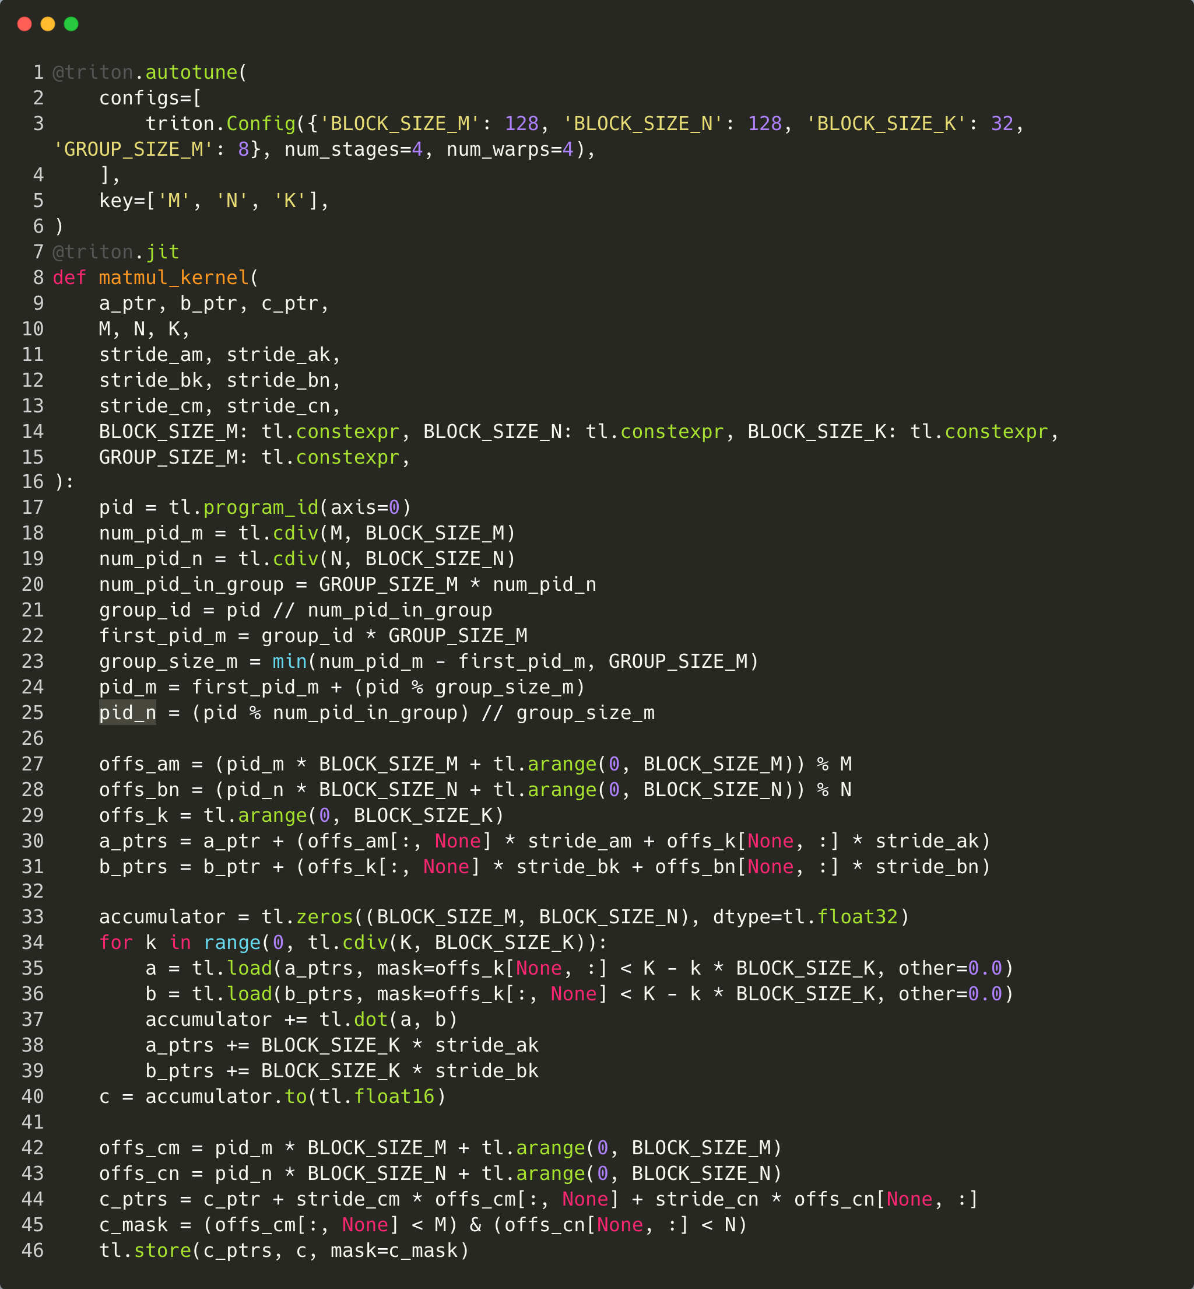
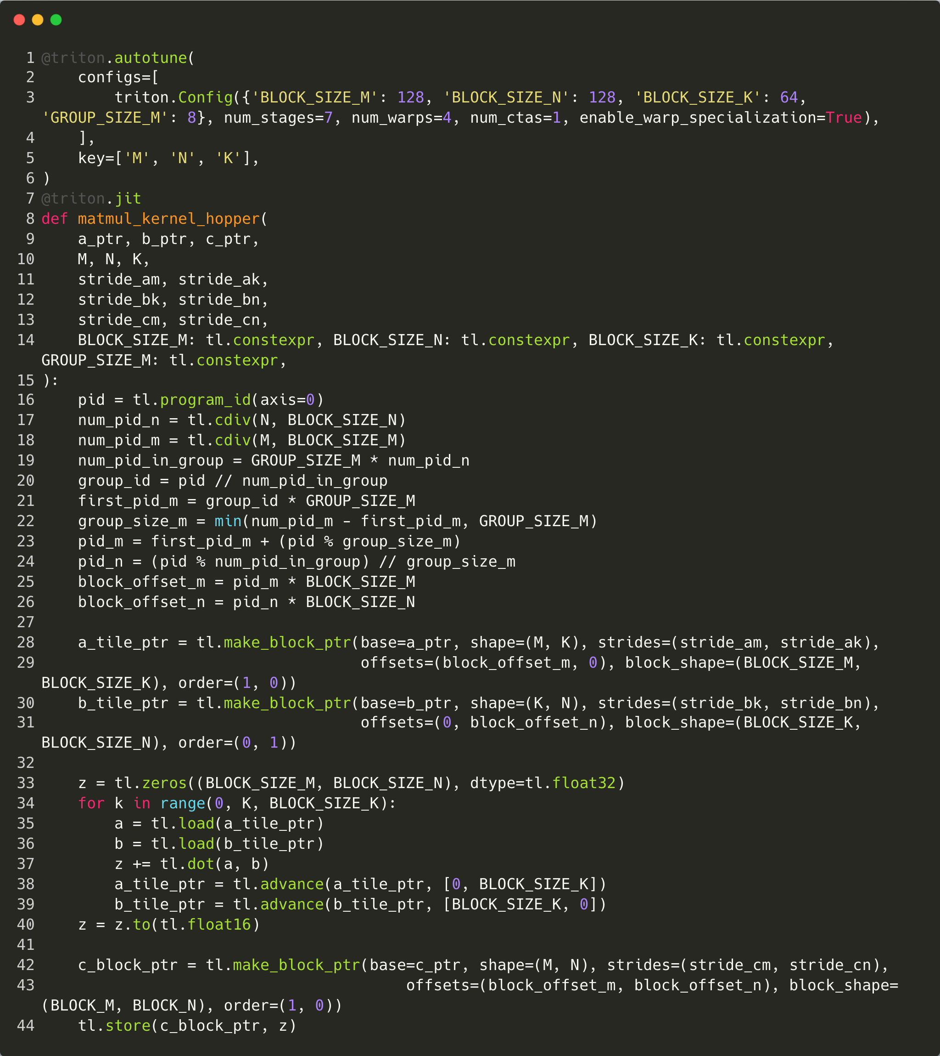
How to use
For float16 data type only(OpenAI folks added the support of FP8/BF16 already)
Hopper features is disabled by default.
export ENABLE_TMA=on and export ENABLE_MMA_V3=on to enable
https://github.com/openai/triton

Slide 19
Agenda
• | Motivation
• | New features & API Changes
• | Dialects & Pass pipelines
• | Performance
• | Plans for the future

Slide 20
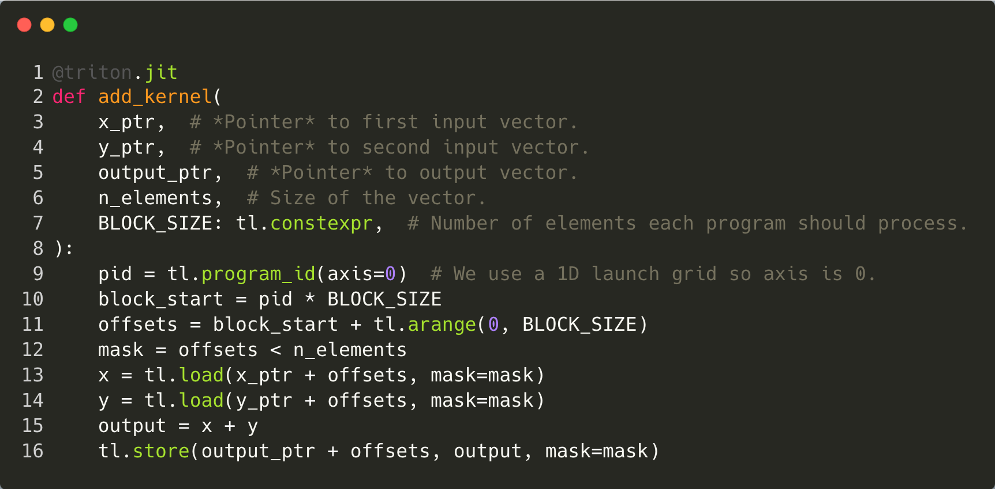
Triton work flow
Frontend
Python @jit
Python AST
Triton
TritonGPU
TritonNvidiaGPU
LLVM / NVVM

Slide 21
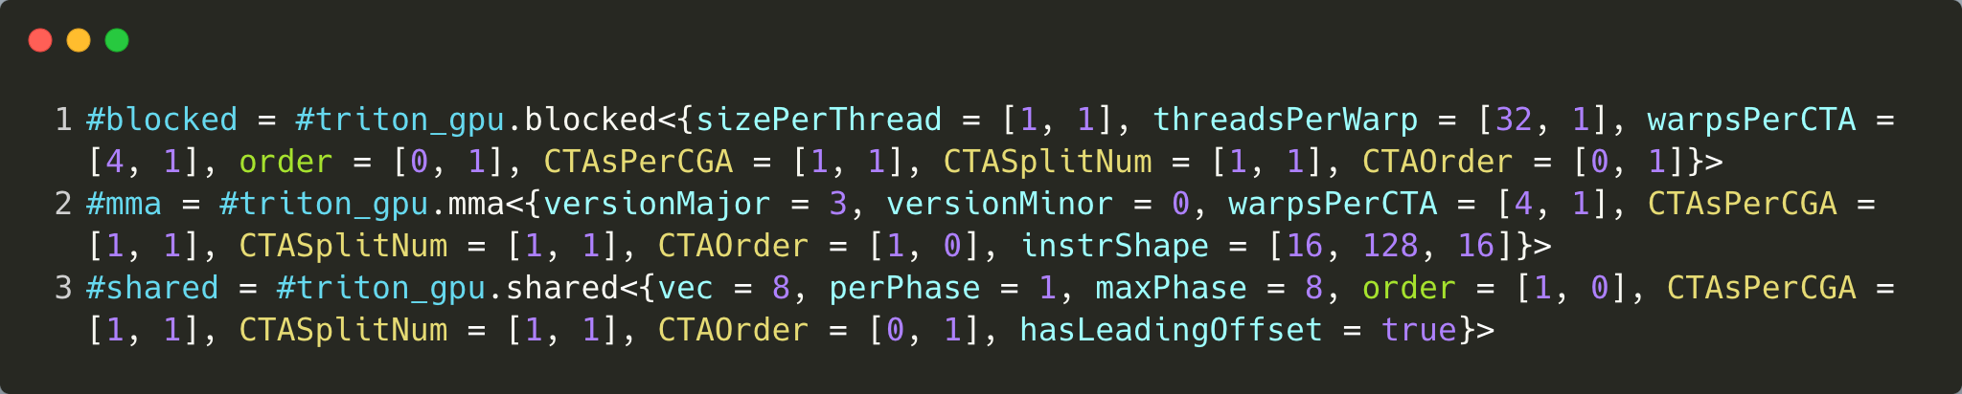
Triton work flow
New added dialects and attributes
CTA -> CGA (BlockedEncoding, MMAEncoding, SharedEncoding)
CTAsPerCGA, CTASplitNum, CTAOrder
WGMMA (MMAEncoding, SharedEncoding)
versionMajor, hasLeadingOffset
New added operations
Barriers | AllocMBarrierOp, ExtractMBarrierOp, MBarrierWaitOp, MBarrierArriveOp, ClusterArriveOp, ClusterWaitOp …
TMA | InsertSliceAsyncV2Op, StoreAsyncOp
WGMMA | DotAsyncOp, DotWaitOp
For Warp Specialization | ProducerAcquireOp, ProducerCommitOp, ConsumerWaitOp, ConsumerReleaseOp, LockOp, UnlockOp …
Python @jit
Python AST
Triton
TritonGPU
TritonNvidiaGPU
LLVM / NVVM

Slide 22
Triton work flow
Overview of pass pipelines
A new pass for CGA->CTA tiling & optimization to avoid unnecessary dsmem traffic. This also implicitly make optimization strategies for TMA multicast
coalesce
plan_cta
Assign MmaEncodingAttr for dots. We added MMAv3 support to this pass.
accelerate_matmul
A new optional pass to bypass shared memory and store to global memory from MMAEncoding directly
optimize_epilogue
Pipeline loops to overlapping between loads and dots, we make this pass pipeline WGMMA dots and TMA loads with async semantics.
pipeline
warp_specialize
materialize_load_store
A couple of new passes for auto warp specialization.
prefetch
A new pass to materialize remaining loads/stores after pipeline pass with proper instructions.
remove_layout_conversions
reorder_instructions
Remove redundant layout conversions, We make it adapt for GMMA in case A/B from shared memory.
fence_insertion
A new pass to insert proper fence between operations who use different memory proxies, LoadOp and DotAsyncOp .e.g.
CSE, DCE …
enable_warp_specialization=False
enable_warp_specialization=True
Python @jit
Python AST
Triton
TritonGPU
TritonNvidiaGPU
LLVM / NVVM

Slide 23
Triton work flow
Hide the complexity of TMA multicast & distributed shared memory
PlanCTA Pass (CGA->CTA tiling)
Select key ops and assign layout
Propagate to other ops, minimizing the number of layout conversion across CTAs
coalesce
plan_cta
accelerate_matmul
optimize_epilogue
pipeline
warp_specialize
…
…
materialize_load_store
prefetch
key op (dot, reduce)
remove_layout_conversions
reorder_instructions
…
fence_insertion
CSE, DCE …
enable_warp_specialization=False
enable_warp_specialization=True
Python @jit
Python AST
Triton
TritonGPU
TritonNvidiaGPU
LLVM / NVVM

Slide 24
Triton work flow
Better overlapping between data movement and math instructions
Prelogue
Math
coalesce
IR Graph
decompose
Subgraphs
plan_cta
Epilogue
accelerate_matmul
optimize_epilogue
pipeline
pipeline
warp_specialization
materialize_load_store
Time Line
prefetch
Warp group1
Tile1
Prelogue
Tile2
Prelogue
Tile3
Prelogue
Tile4
Prelogue
remove_layout_conversions
Tile1 Math | Tile1 Epilogue
Tile3 Math | Tile3 Epilogue
reorder_instructions
Warp group2
fence_insertion
Warp group3
Tile2 Math | Tile2 Epilogue
Tile4 Math | Tile4 Epilogue
CSE, DCE …
enable_warp_specialization=False
enable_warp_specialization=True
Python @jit
Python AST
Triton
TritonGPU
TritonNvidiaGPU
LLVM / NVVM

Slide 25
Triton work flow
Backend
TritonGPU/TritonNvidiaGpu Dialect
TritonGPU/TritonNvidiaGpu Dialect
A temporary solution since NVVM is not ready to support Hopper features
May be merged into NVVM dialect/NVVM IR ideally in the future
LLVM/NVVM Dialect
with inline PTX
LLVM/NVVM Dialect
LLVM/NVVM IR
with inline PTX
LLVM/NVVM IR
PTX
PTX
Python @jit
Python AST
Triton
TritonGPU
TritonNvidiaGPU
LLVM / NVVM

Slide 26
Agenda
• | Motivation
• | New features & API Changes
• | Dialects & Pass pipelines
• | Performance
• | Plans for the future

Slide 27
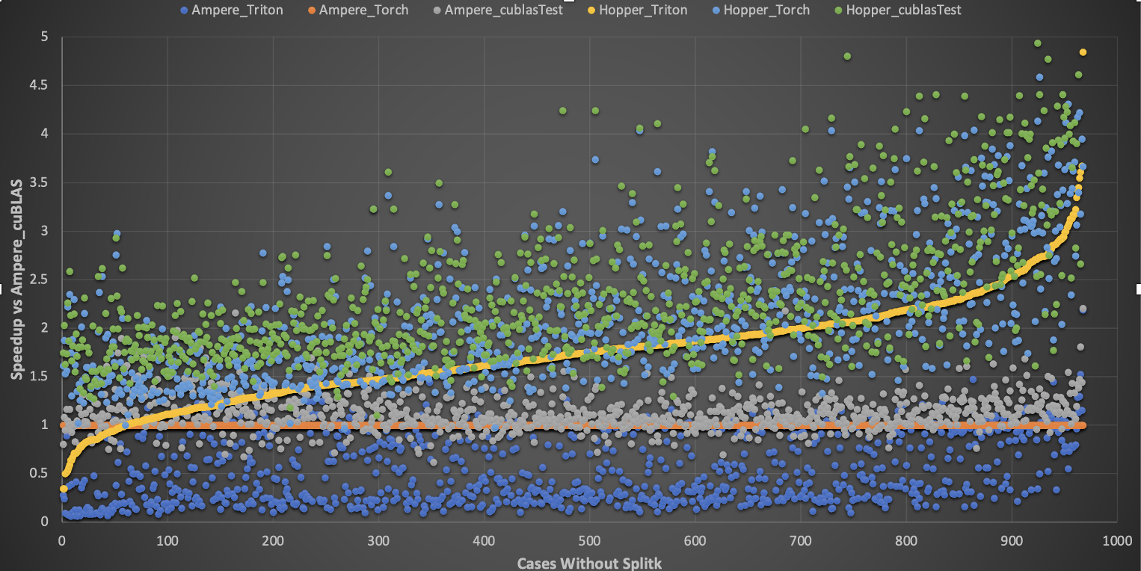
Performance of float16 GEMM
2
2
1.84
30% perf gap
26% perf gap
1.5
A100 cuBLAS
1.49
Speedup
1.41
1.12
H100 Triton un-warpspecialized
1
1
1.06
1
H100 Triton warpspecialized
0.5
H100 cuBLAS
0
With SplitK shapes
Without SplitK shapes
A100 SXM 80G, H100 SXM 80G
SplitK GEMM can be implemented with the Triton front end APIs, but it is not our focus for now.
Notes:
Torch
compiled with CUDA 12.0
Version: 2.1.0a0+gitdcc159d
CUDA
V12.0 public
cuBLAS
12.0.1.189
OAI Triton

Slide 28
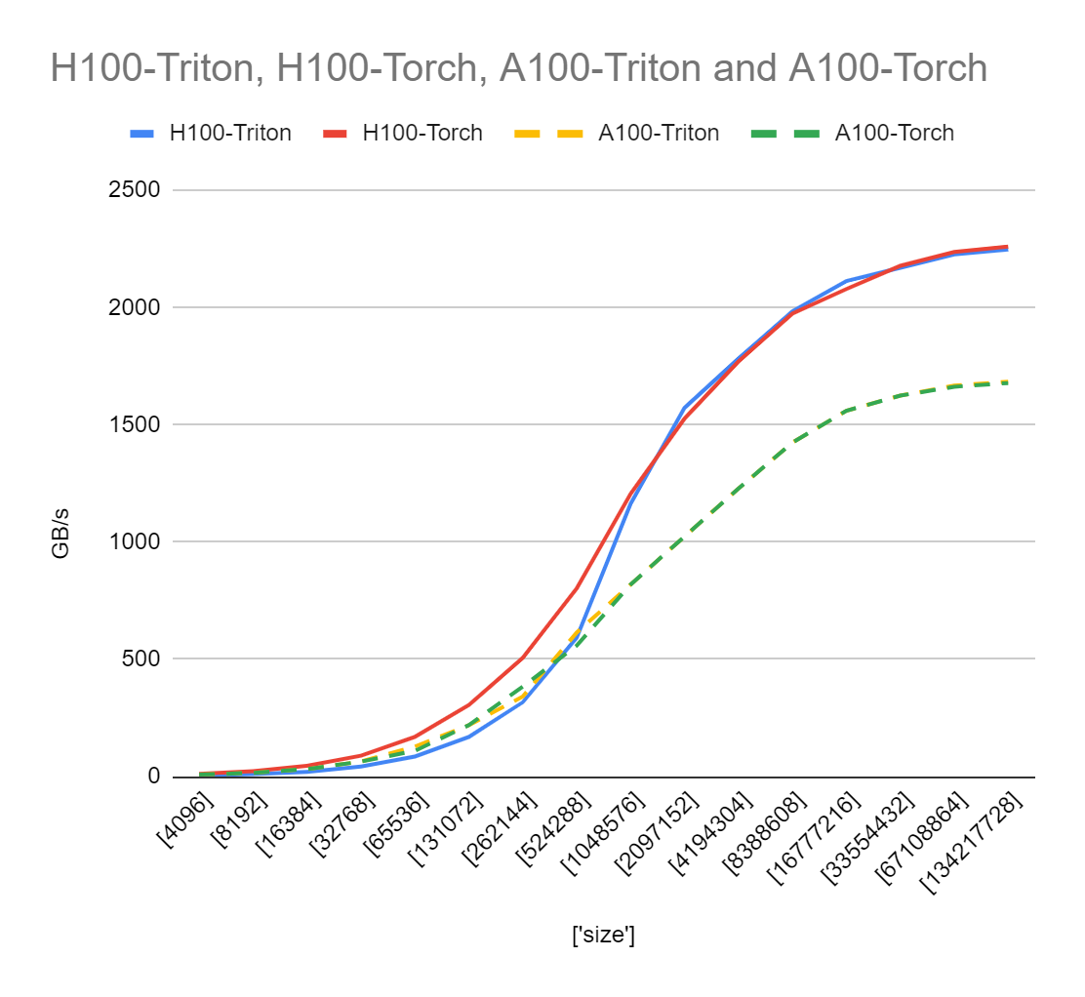
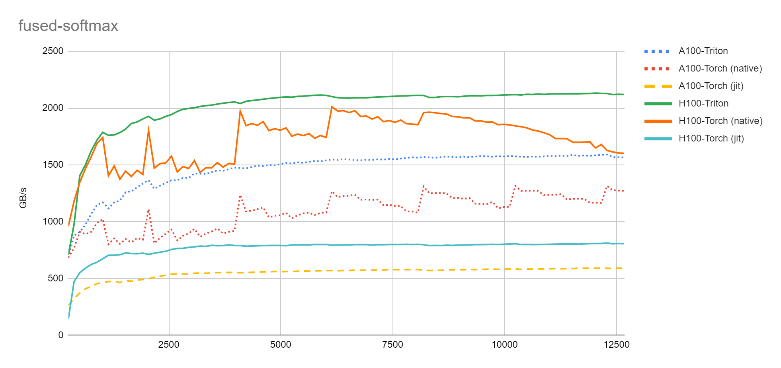
Performance of Triton on Hopper
Vector Add
Fused Softmax
https://github.com/openai/triton/tree/main/python/tutorials

Slide 29
Agenda
• | Motivation
• | New features & API Changes
• | Dialects & Pass pipelines
• | Performance
• | Plans for the future

Slide 30
Plans for the future
Performance optimization of the warp specialized kernel.
Turn on the new features on Hopper by default in Triton.
Optimizing other kernels, e.g., flash-attention.
…

Slide 31
Thank you

Slide 32
Motivation
Triton pre-Hopper kernels can run on Hopper by re-compilation, no changes necessary.
Hopper New Features | API changes required | API breaks Ampere? | Reasons
CGA | No | N/A | Only new potential perf tuning knobs(num_ctas) exposed, with the default value of the tuning knobs set by Triton compiler itself. Other details hidden by Triton compiler
TMA | Yes | No | New tl.make_block_ptr API(and corresponding data type) is introduced to create pointer of Tensor to help utilize TMA
WGMMA | No | N/A | tl.dot operation can get lowered into sequence of different MMA instructions based on Ampere/Hopper arch information. Details completely hidden by Triton compiler.
Warp-specialization(new SW paradigm) | No | N/A | Triton Hopper compiler provides the support of auto warp-specialization, details hidden by Triton compiler.

